Slide 1
Machine Learning Model for Prediction and Forecasting of CO2 Emission with Exploratory Data Analysis:
BY:
I.Suprateek-208R1A6785
D. Upender Reddy-208R1A6777
P.Prathyusha-208R1A67A7
B.Sai Aravind-208R1A67B7
Naseer Baba-218R5A6710

Slide 2
Contents:
Abstract/Introduction
Literature Survey/Existing System
Disadvantages of existing system
Proposed system
Advantages of proposed system
Hardware and Software requirements
UML Diagrams
Testing and Output
Conclusion
Future Scope
References

Slide 3
Abstract/Introduction:
The emission of carbon dioxide (CO2) into the Earth's atmosphere is a critical issue that has garnered increasing attention in the context of global environmental sustainability.
This abstract provides an overview of the current state of CO2 emissions, their environmental impact, and explores potential sustainable solutions. CO2, primarily generated from human activities such as fossil fuel combustion, deforestation, and industrial processes, contributes significantly to the greenhouse effect and climate change.
Furthermore, it delves into innovative approaches and technologies aimed at mitigating CO2 emissions, including renewable energy sources, carbon capture and storage, and policy measures to incentivize sustainable practices. Understanding the complexities of CO2 emissions and implementing effective strategies to reduce them is crucial for addressing the challenges posed by climate change and fostering a more sustainable future.

Slide 4
Literature survey/Existing system:
K-Nearest neighbours (KNN) is a simple yet powerful supervised machine learning algorithm used for classification and regression tasks.
It's based on the idea that data points with similar features tend to belong to the same class or have similar values in the case of regression.
KNN is a distance-based classification algorithm. It assigns a new data point to the majority class of its k-nearest neighbours.
The choice of 'k' (the number of neighbours) is a crucial hyper parameter that impacts the model's performance. KNN is an instance-based learning method, meaning it doesn't build a model during training. Instead, it memorizes the entire training dataset and uses it for predictions.

Slide 5
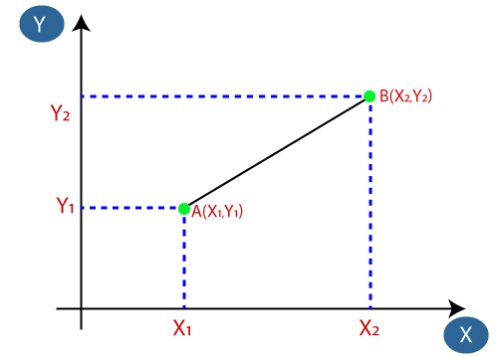
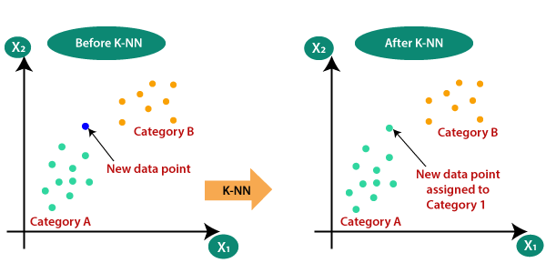
KNN Initialization
Distance measurement in KNN

Slide 6
Disadvantages of existing system:
KNN's performance is highly dependent on the choice of distance metric. The algorithm may yield different results with different distance metrics (e.g., Euclidean, Manhattan, etc.), and selecting the right metric can be challenging.
KNN requires calculating the distance between the query point and all data points in the training set. For large datasets, this can be computationally expensive and slow, making real-time predictions difficult.
In high-dimensional feature spaces, the distance between data points becomes less meaningful. This phenomenon, known as the "curse of dimensionality," can adversely affect KNN's performance, as distances lose their discriminatory power
KNN is sensitive to noisy data or outliers, as they can significantly affect the distance calculations. Outliers can lead to incorrect predictions and decrease model performance. For large datasets, this can consume a substantial amount of memory.

Slide 7
Proposed System:
We generally follow 6 steps in order to optimize the prediction of emission of CO2 and forecasting under machine learning. They are:
Exploratory Data Analysis (EDA)
Data Pre-processing
Existing KNN Model
Proposed KNN Model
Prediction
Performance Estimation

Slide 8
Advantages of proposed system:
Data Driven Insights
Baseline Model
Prediction Capability
Performance Evaluation
Sustainability Impact
Research Expansion

Slide 9
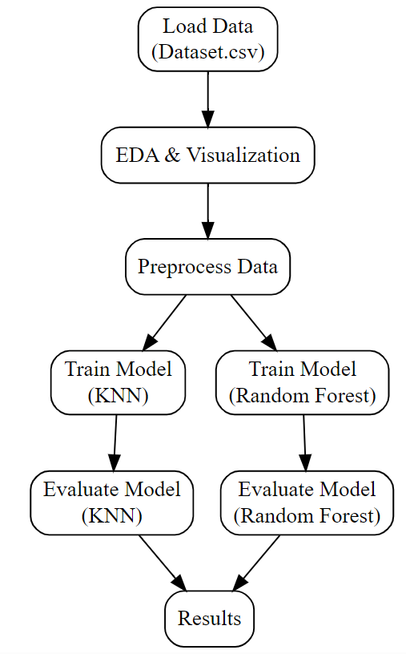
Block Diagram of proposed system

Slide 10
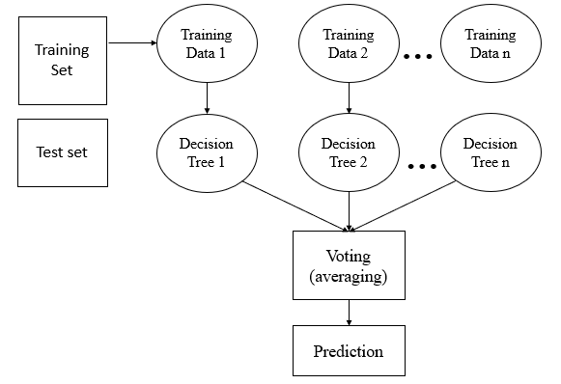
Block diagram of RFC(Random Forest Classification) model

Slide 11
Hardware and Software Requirements:
Software Requirements
Jupyter notebook (or) Google colab
Hardware Requirements
Operating system : Windows or Linux
Processor : intel i3 5th gen and above
Ram : 4 GB and above
Hard disk : 256GB and above

Slide 12
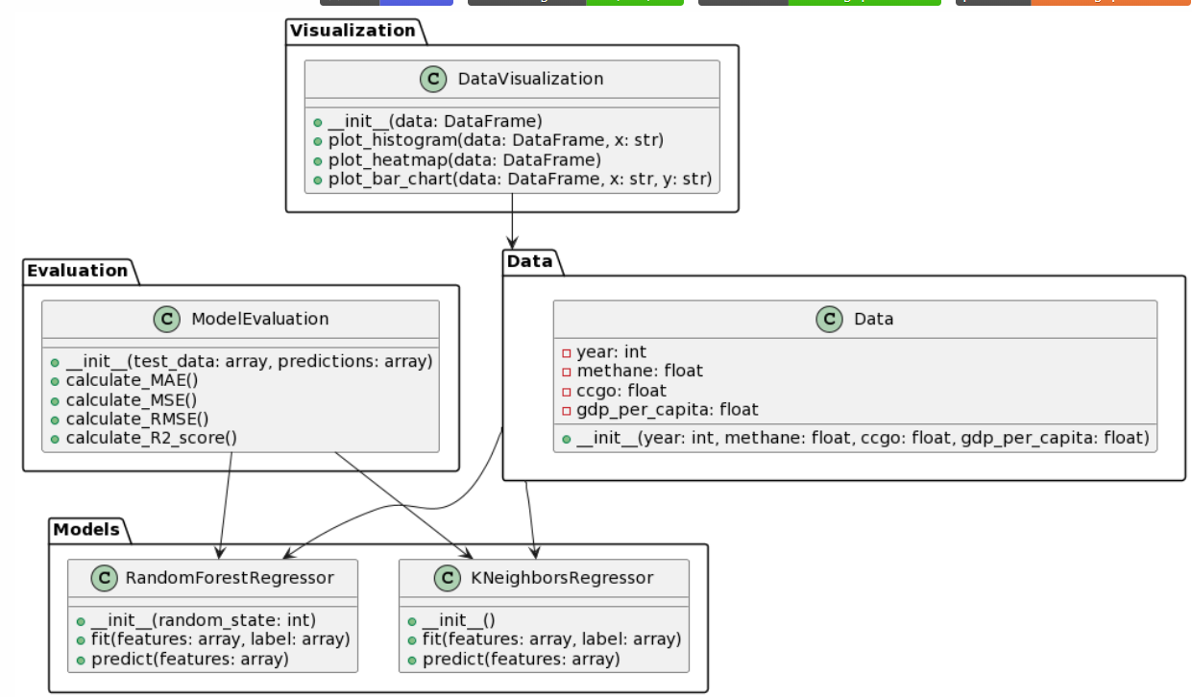
UML Diagrams:
Class Diagram:
The class diagram is used to refine the use case diagram and define a detailed design of the system.

Slide 13
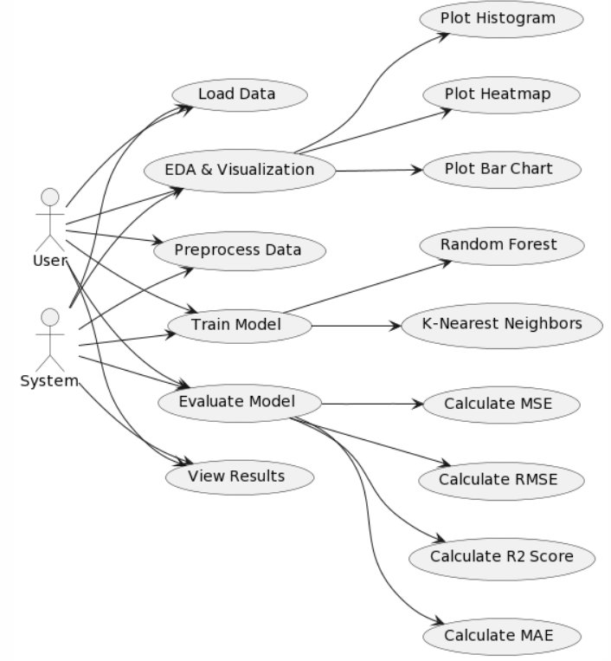
Use-Case Diagram:
A use case diagram in the Unified Modelling Language (UML) is a type of behavioural diagram defined by and created from a Use-case analysis. Its purpose is to present a graphical overview of the functionality provided by a system in terms of actors, their goals (represented as use cases), and any dependencies between those use cases

Slide 14
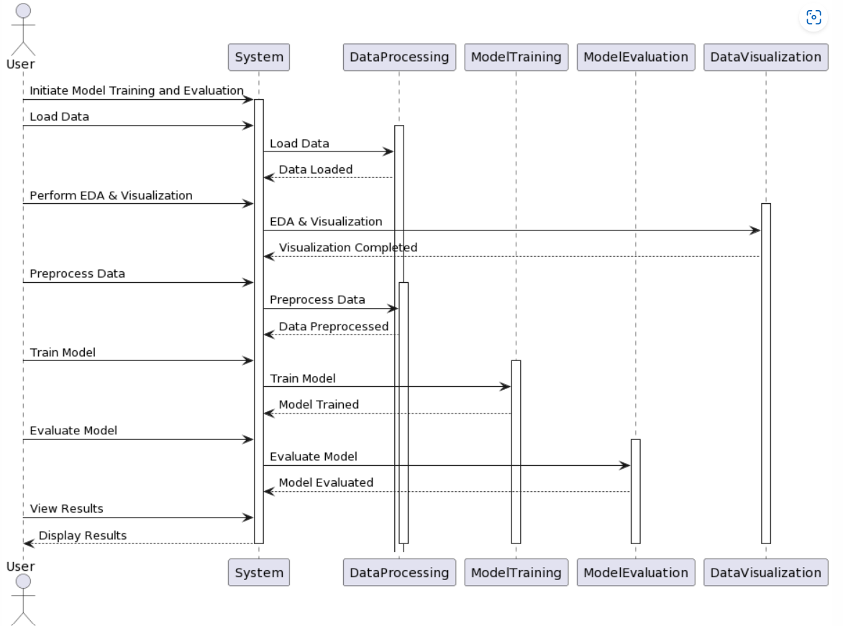
Sequence Diagram:
A sequence diagram in Unified Modelling Language (UML) is a kind of interaction diagram that shows how processes operate with one another and in what order. It is a construct of a Message Sequence Chart.

Slide 15
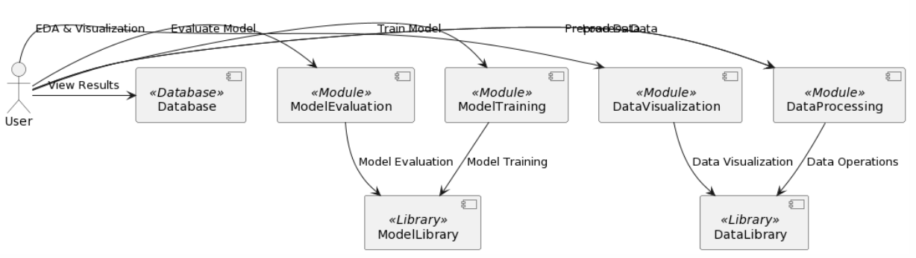
Component Diagram:
A component diagram in Unified Modeling Language (UML) is a type of diagram that illustrates the components or parts of a system, along with the dependencies between these components. It's used to depict the organization and relationships between software components in a system.

Slide 16
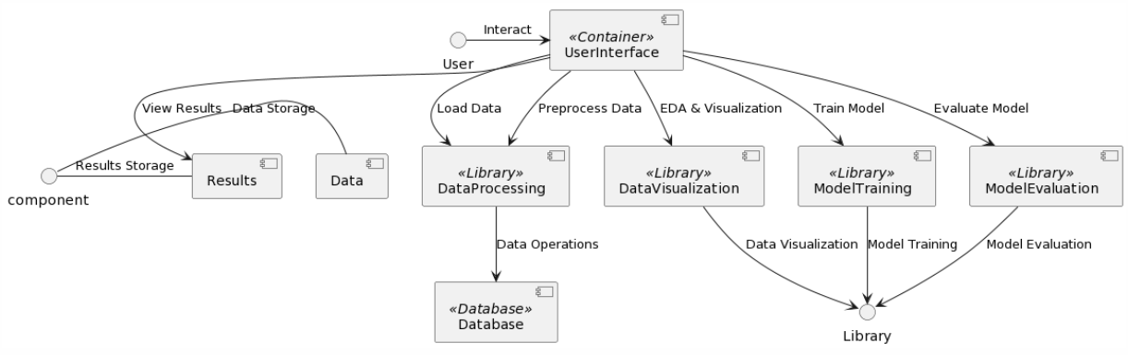
Deployment diagram:
The deployment diagram visualizes the physical hardware on which the software will be deployed.

Slide 17
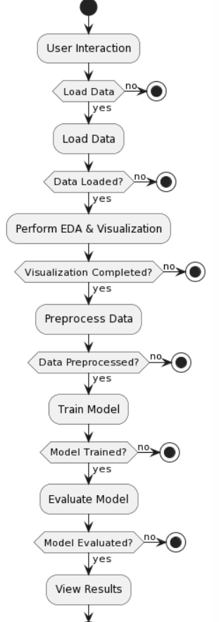
Activity diagram:
Activity diagrams are graphical representations of Workflows of stepwise activities and actions with support for choice, iteration, and concurrency. In the Unified Modelling Language, activity diagrams can be used to describe the business and operational step-by-step workflows of components in a system.

Slide 18
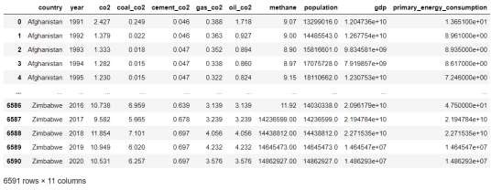
Testing and outputs:
Sample Dataset used for CO2 emission

Slide 19
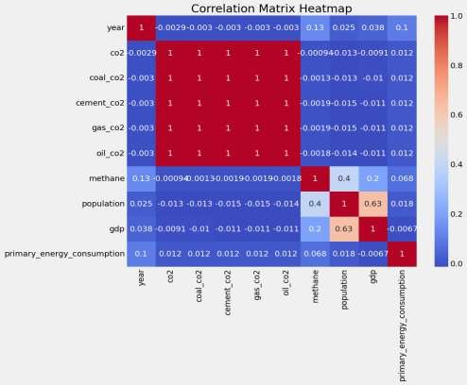
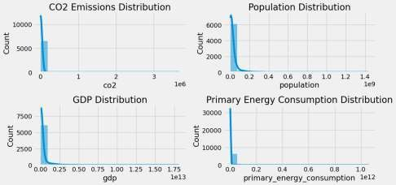
Subplot displaying emission of Co2
Correlation Matrix

Slide 20
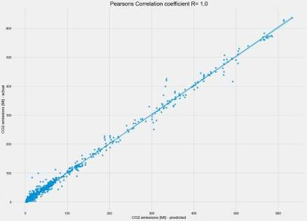
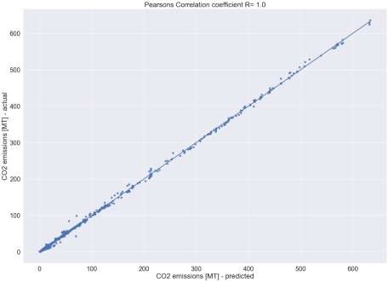
Predictions using KNN
Predictions using RFC in KNN model

Slide 21
Future Scope:
Looking ahead, the future scope of this research is promising. Firstly, the refinement and improvement of machine learning models can enhance prediction accuracy and reliability. Researchers can explore advanced deep learning techniques and ensemble methods to further optimize CO2 emission forecasts.
Additionally, incorporating real-time data sources and satellite imagery for monitoring and updating emissions data will make the models more dynamic and responsive to changing environmental conditions.
Furthermore, the integration of socioeconomic and policy-related variables can provide a more comprehensive understanding of the drivers of CO2 emissions, facilitating the development of targeted and effective climate policies. Collaboration between researchers, governments, and environmental organizations will be crucial in collecting high-quality data and implementing the findings into actionable policies. Ultimately, the future scope of this research lies in its potential to drive meaningful change in our efforts to combat climate change and protect our planet for future generations.

Slide 22
Conclusion:
In conclusion, the integration of machine learning models and exploratory data analysis (EDA) techniques offers a powerful approach for predicting and forecasting CO2 emissions, addressing the critical issue of climate change and its environmental consequences.
Through this research, we have demonstrated the potential of machine learning to analyze large and intricate datasets, revealing hidden patterns and relationships that traditional statistical methods might miss. EDA has proven invaluable in providing a deeper understanding of the data, enabling the identification of influential features and outliers.
By combining these two approaches, we can offer accurate and reliable predictions of CO2 emissions, empowering policymakers and environmentalists with valuable insights to develop effective strategies for emission reduction and sustainability. This work not only contributes to the scientific understanding of the factors driving CO2 emissions but also has practical implications in optimizing resource allocation, promoting renewable energy sources, and planning adaptation measures to mitigate the consequences of global warming.

Slide 23
References:
[1] Intergovernmental Panel on Climate Change (IPCC). Contribution of Working Group III to the Sixth Assessment Report of the Intergovernmental Panel on Climate Change; Shukla, P.R., Skea, J., Slade, R., Al Khourdajie, A., van Diemen, R., McCollum, D., Pathak, M., Some, S., Vyas, P., Fradera, R., et al., Eds.; Cambridge University Press: Cambridge, UK, 2022. [Google Scholar]
[2] Song, M.; Zhu, S.; Wang, J.; Zhao, J. Share green growth: Regional evaluation of green output performance in China. Int. J. Prod. Econ. 2020, 219, 152–163.
[3] Wang, W.W.; Zhang, M.; Zhou, M. Using LMDI method to analyze transport sector CO2 emissions in China. Energy 2011, 36, 5909–5915.
[4] Jing, Q.; Bai, H.; Luo, W.; Cai, B.; Xu, H. A top-bottom method for city-scale energy-related CO2 emissions estimation: A case study of 41 Chinese cities. J. Clean. Prod. 2018, 202, 444–455.
[5] Wang, H.; Chen, Z.; Wu, X.; Nie, X. Can a carbon trading system promote the transformation of a low-carbon economy under the framework of the porter hypothesis?—Empirical analysis based on the PSM-DID method. Energy Policy 2019, 129, 930–938.

Slide 24


